Slide 1
Roger Stone’s threatening post to Amy Berman Jackson on Instagram
Naga Vamsi Krishna Pabbisetty
March-20-2019

Slide 2
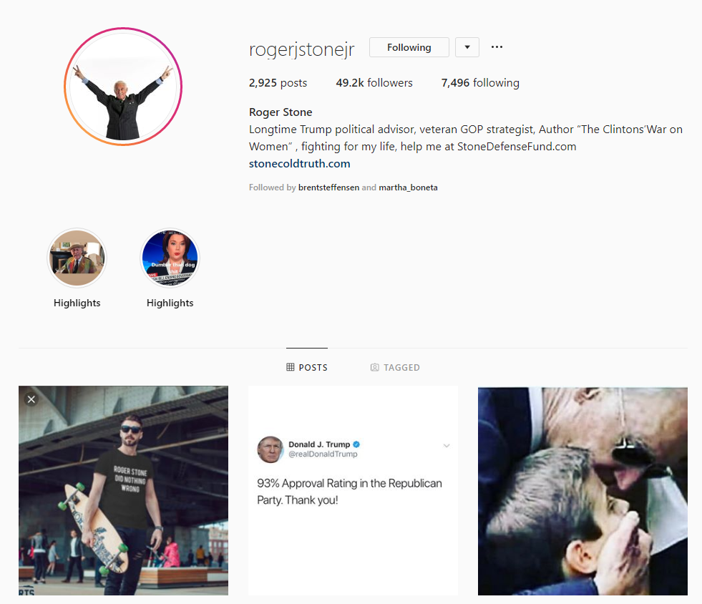
Roger Stone
https://www.instagram.com/rogerjstonejr/

Slide 3
In Trial
Accused of being one among the people who meddled with 2016 US Elections
Accused of being in contact with the Russian hacker/Russian disinformation campaign and being in contact with Julian Assange, founder of WikiLeaks during the elections
Sometimes called as a “Trickster”

Slide 4
Amy Berman Jackson
Appointed as a Federal Judge by Barack Obama in 2010
In January 2019, she was assigned the case of Roger Stone who is indicted of seven counts including false statements, obstruction, and witness tampering
Imposed a limited gag order on Roger Stone on Feb 15, this year
No Twitter, Facebook or Instagram accounts

Slide 5
Timeline of events
Feb 15
Judge Jackson Imposes a limited gag order on Roger Stone,
where he can discuss his case in public anywhere except in DC
Feb 18
Morning
Roger Stone uploads picture of the Judge
with a crosshair(considered as a threat) and calls “Robert Mueller” as a hitman in Instagram
Feb 18
Later he removes the post and adds another picture of Judge Jackson without the crosshair
(without referring to “Robert Mueller” as hitman) and later deletes this post as well
Feb 18
His Lawyers sends an apology to the Judge Jackson on his behalf
Feb 18
His Lawyers sends an apology to Judge Jackson on his behalf
Feb 21
Judge Jackson tightens the gag order,
where he cannot speak about the case in public/social media

Slide 6
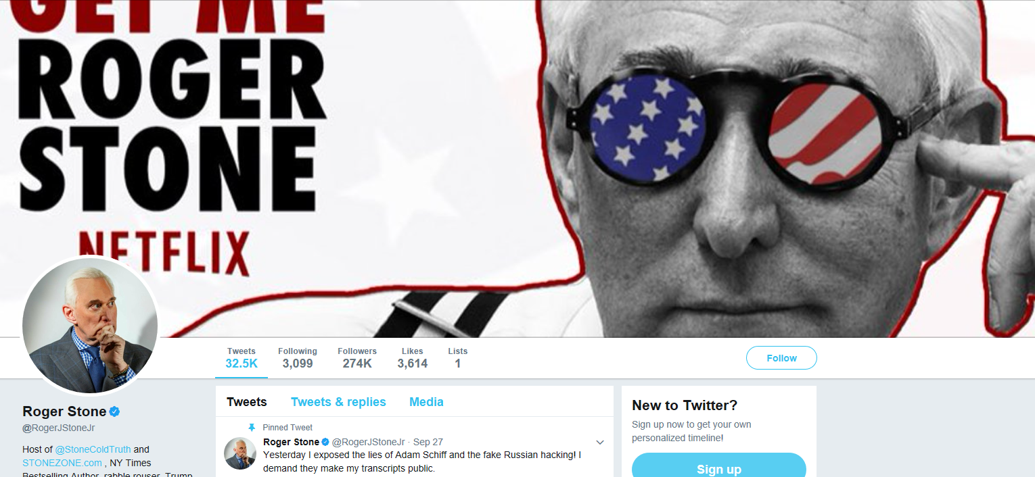
Twitter Account - Suspended
https://web.archive.org/web/20170928135903/https:/twitter.com/rogerjstonejr

Slide 7
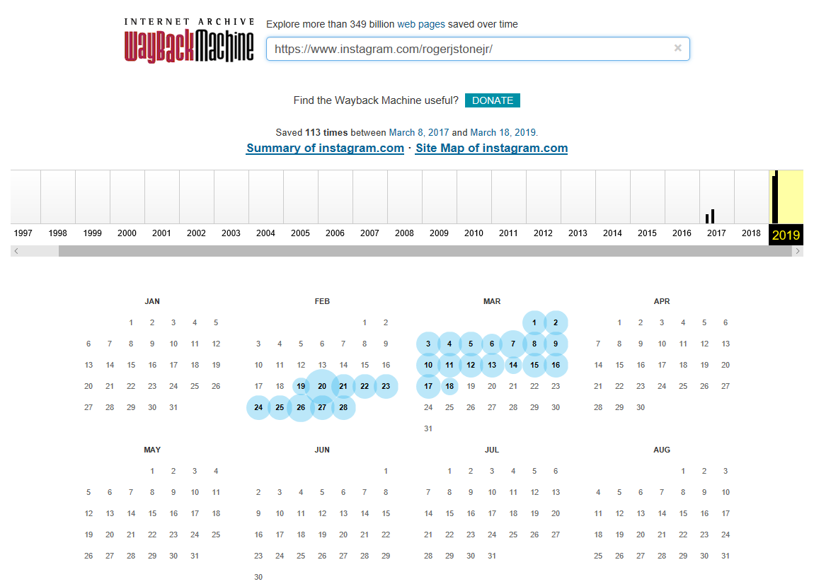
Available Instagram mementos of Roger Stone
https://web.archive.org/web/20190801000000*/https://www.instagram.com/rogerjstonejr/

Slide 8
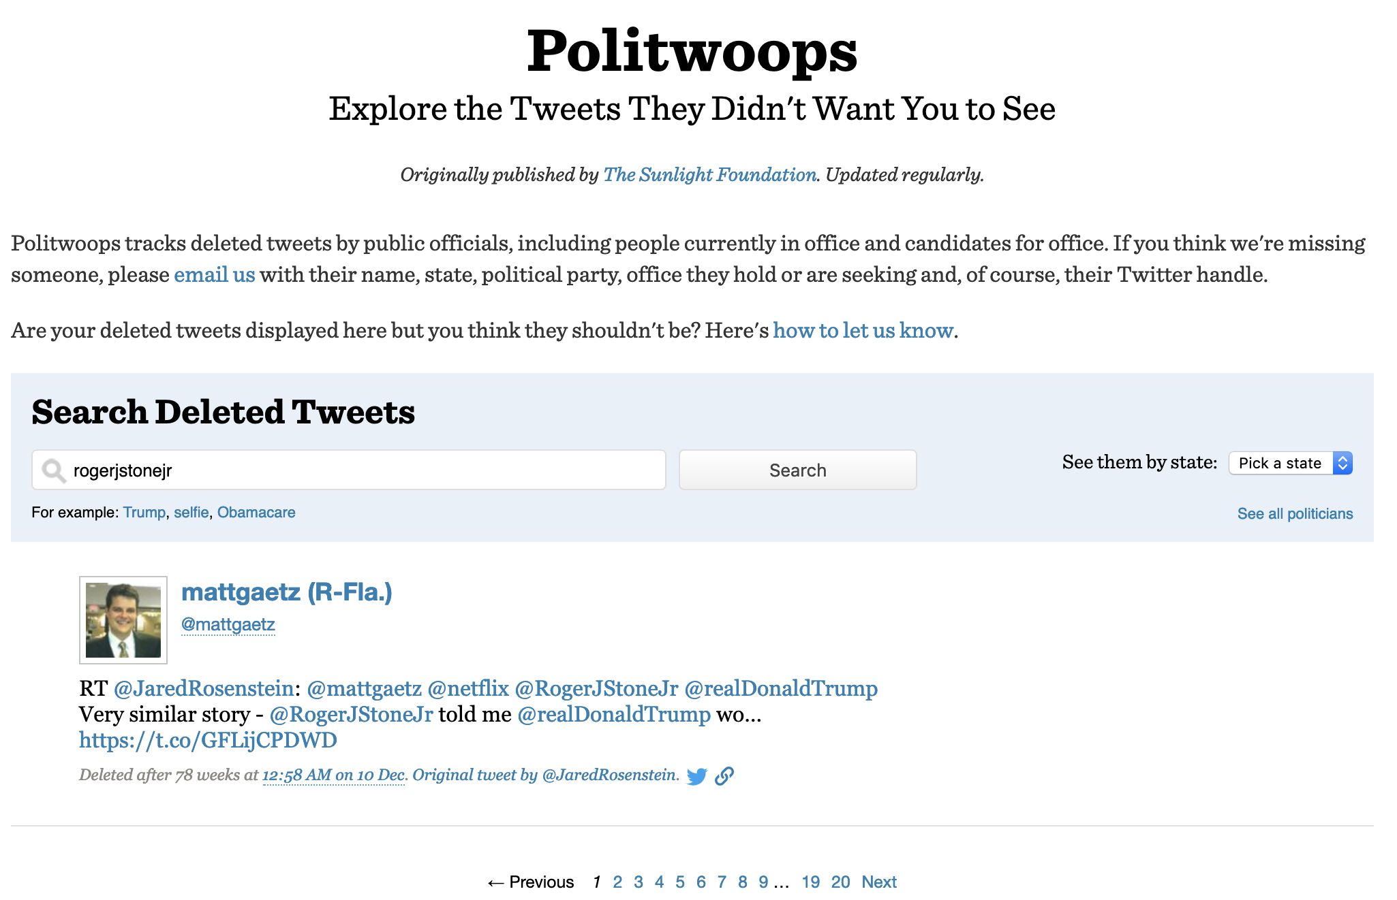
No information about Roger Stone on Politwoops
https://projects.propublica.org/politwoops/index?utf8=%E2%9C%93&q=rogerjstonejr

Slide 9
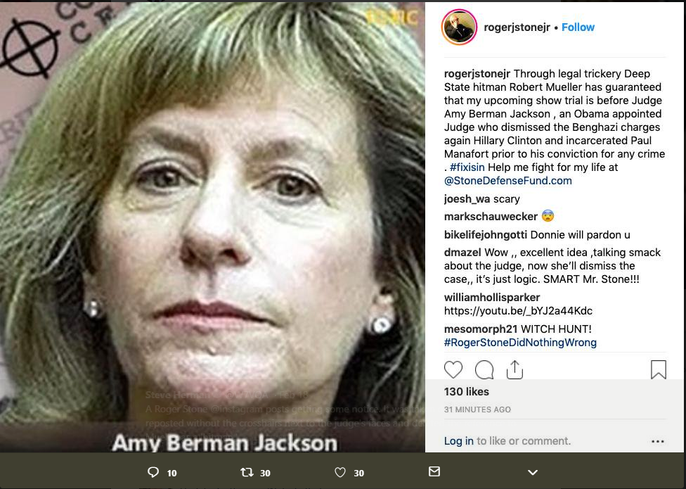


Roger Stone’s Threatening post on Instagram
https://twitter.com/W7VOA/status/1097603079048962051

Slide 10
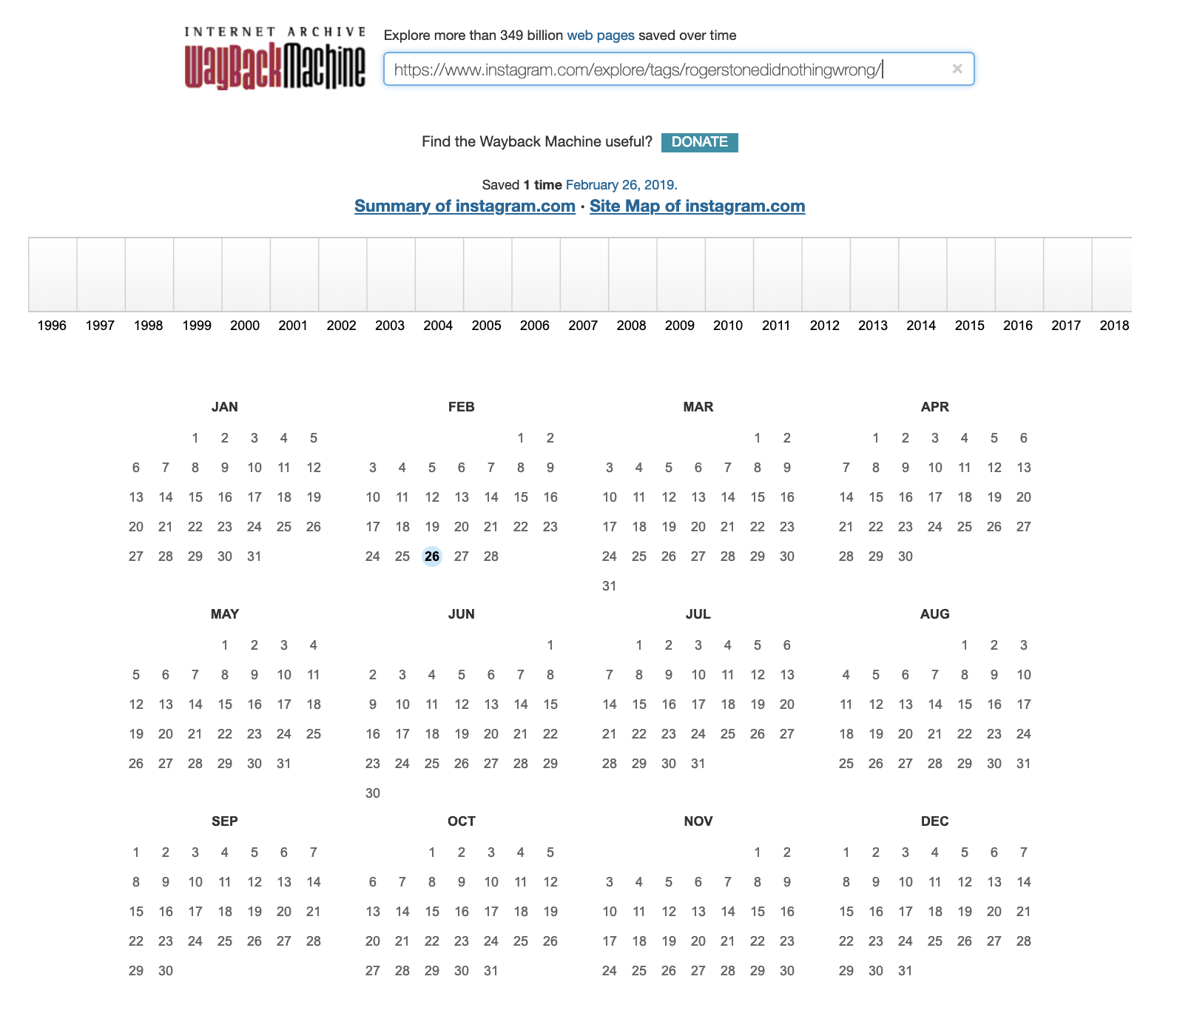
Mementos for #rogerstonedidnothingwrong
https://www.instagram.com/explore/tags/rogerstonedidnothingwrong/

Slide 11
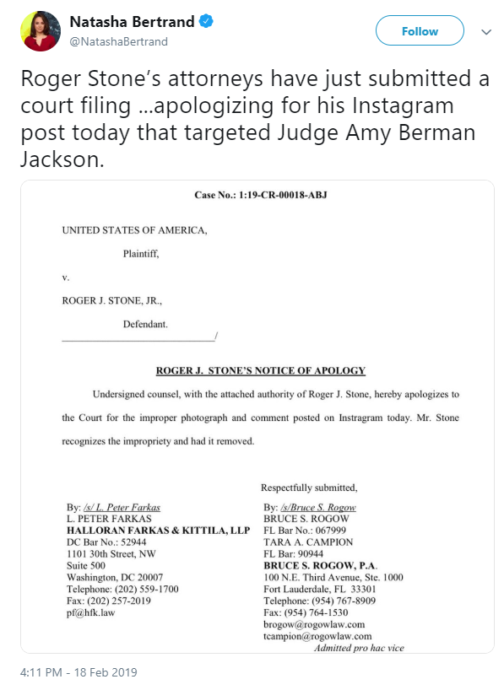
Roger Stone’s apology to Judge Jackson
https://twitter.com/NatashaBertrand/status/1097649860990390272

Slide 12
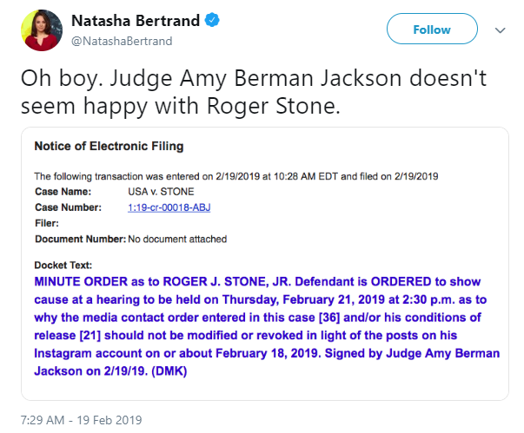
Judge Jackson registers a complaint against Roger Stone
https://twitter.com/NatashaBertrand/status/1097880949935800320

Slide 13
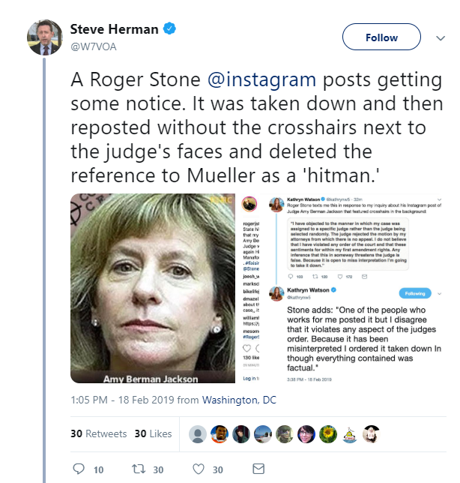
Steve Herman’s reference to both the posts
https://twitter.com/W7VOA/status/1097649667343638533

Slide 14
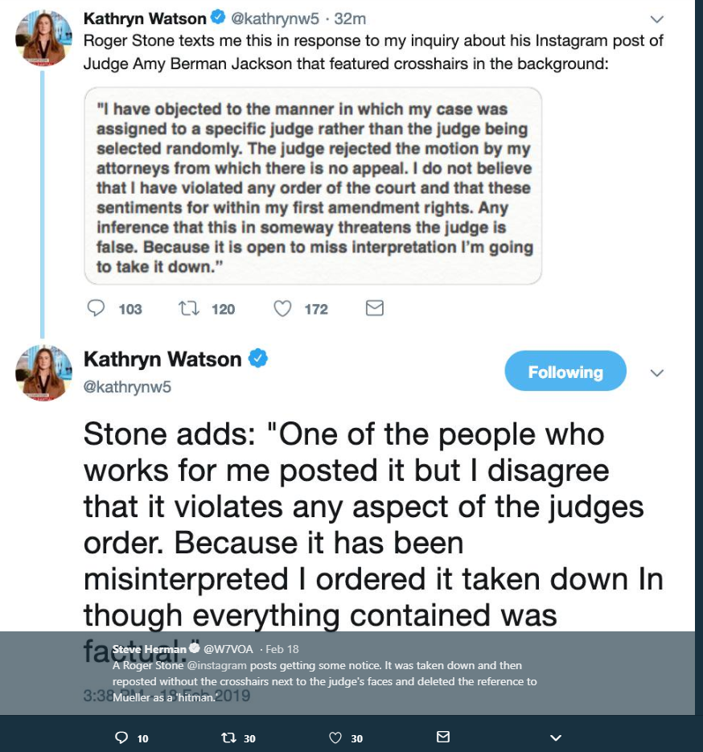
Roger Stone’s response to the Journalist
https://twitter.com/W7VOA/status/1097649667343638533

Slide 15
Judge tightens the gag order on Roger Stone
Feb-21-2019 – Judge Jackson tightens the gag order
Roger Stone cannot speak about his case in public anymore

